Slide 1

The Fight Against ISIS and US Middle East Policy
Daniel Serwer
Scholar, Middle East Institute
Professor, School of Advanced International Studies, Johns Hopkins University
www.peacefare.net
@DanielSerwer
March 19, 2015
IAI

Slide 2
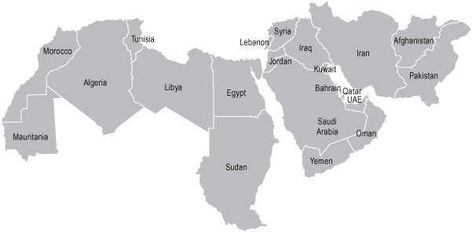
Middle East and North Africa (MENA)
Notes:
Maps from Jones Lang Lasalle website

Slide 3
Context is important
The fight against ISIS is occurring at the center of gravity of the Middle East
Its impacts are felt not only in Iraq and Syria and echo in Lebanon, Israel, Jordan and Iran
The war also occurs along the Sunni/Shia fault line
Saudi Arabia, the other Gulf states and Iran all have vital interests not only in the defeat of ISIS but also how it occurs as well as the aftermath

Slide 4
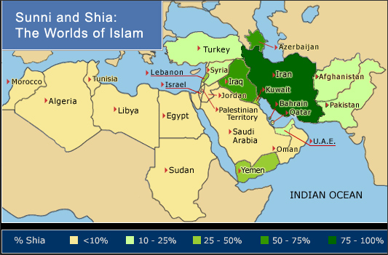

Slide 5
ISIS is not just a terrorist group
President Obama calls it a terrorist group and is trying to use CT methods to kill it
But it is more than a terror group, even if less than a state
It controls and administers territory and significant populations
It acts like an insurgency and has declared itself a caliphate

Slide 6
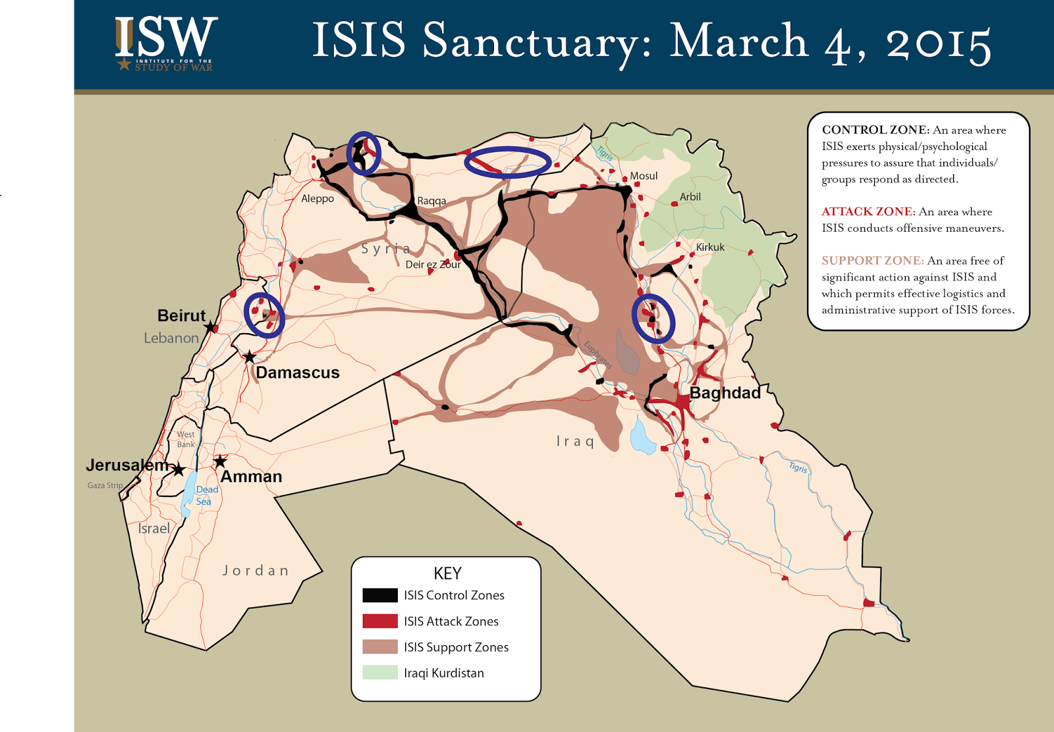
This is what the problem looks like

Slide 7
Brief history of the Islamic State
Roots in Jama'at al-Tawhid wal-Jihad, (Group of Monotheism and Jihad) founded by Jordanian Abu Musab al Zarqawi in 1999
Became known as Al Qaeda in Iraq, joined insurgency against US occupation
AQI supplied and supported from Syria
Zarqawi targeted and killed by US 2006
Group became Islamic State in Iraq
By 2008, largely defeated
80% of leadership killed or captured (Odierno, 2010)

Slide 8
Back from defeat
May 2010 Abu Bakr al Baghdadi takes over ISI
Ba’athists replenish leadership
US withdrawal from Iraq December 2010, negotiated and signed by Bush administration
Revolution begins in Syria spring 2011
Breaking the Walls (2012/13) frees thousands of prisoners in Iraq
ISI establishes and tries to merge with Jabhat al Nusra, as the Islamic State of Iraq and Sham (ISIS)
Al Qaeda rejects and disavows ISIS (2014)
June 2014 Islamic State takes Mosul and declares caliphate

Slide 9
What is a caliphate?
Caliph means “successor”: to Mohammed
Shia/Sunni split based on quarrel about who proper successor was
Sunnis regard Abu Bakr, Mohammed’s close friend, as first Caliph,
Shia think Ali, Mohammed’s cousin and son-in-law, was rightful heir
Difference is method (election vs family)
Comparable to quarrels over legitimacy in Christianity: schisms in the Catholic Church, the Great Schism between Eastern and Western churches or Protestant/Catholic
A caliphate (or more than one) existed more or less from the 7th to the 20th century; ISIS imagines it is imitating early ones
Damascus and Baghdad were capitals of the Umayyad (661-750) and Abbasid (750-1258) caliphates, respectively
Last was the Ottoman Caliphate abolished by Ataturk 1924
Restoration of a “true” caliphate is supposed to occur in the leadup to the return of the Mahdi (messiah) and the end times
Notes:
Abbasid caliphate later in Cairo 1258-1517

Slide 10
What is life like under in the ISIS caliphate?
Strict practices: women cover (niqab), no smoking, Sharia, purifying violence against evil
Ideology is intolerant, anti-Western, anti-Shia
Authoritarian governance through two deputies and local governors in Iraq and Syria
Services delivered (water, electricity), taxes collected, law enforced, schools open

Slide 11
Most Sunnis don’t like ISIS
In recent polling, Munqith Dagher finds in ISIS-controlled areas of Syria ISIS support is at 13%
In Iraq, 97% view ISIS as a terrorist organization
But they don’t necessarily like the anti-ISIS coalition either: yes in Iraq and Libya, no in Syria and Yemen
In Syria, support is stronger for the Coalition in ISIS-controlled areas than in opposition or regime-controlled areas
Also stronger among Sunnis than Shia
BUT: if given a choice between ISIS and Shia militias, Sunnis prefer ISIS

Slide 12
How did this happen?
Bashar al Assad focused his attacks on moderates, allowed the Islamic State to thrive
Nouri al Maliki ran an exclusionary show, accused Sunni leaders, ignored protests
Security forces in both countries became increasingly sectarian, driving Sunni population towards extremists
The Islamic State was smart, patient and ferocious

Slide 13
The new Republic of Fear
West marvels at the use of social media, level and types of violence
But it is both necessary and productive for ISIS
It intimidates large numbers of people to comply and helps recruitment
Nothing succeeds like success, but nothing fails like failure
If we are able to begin to push ISIS back, it will lose a lot of its appeal

Slide 14
US reacted slowly
US Administration slow to recognize risk
Thought Iraqi army could/would fight/contain
ISIS advanced against Kurds, Yezidis June/July 2014 prompted unilateral bombing in August
Only August/September 2014 beheading of 2 American journalists stirred coalition effort
So we are less than six months into a counter-insurgency campaign
CI typically last 10-15 years!

Slide 15
The anti-ISIS war effort now
Inherent Resolve Coalition: 60 countries participating, 20 with milops in Iraq, Syria or both
Mainly air attacks: 60% US
4500 US troops in Iraq, plus civilian support
AUMF debate in Washington: legally irrelevant, politically important
Ds want less, Rs want more (especially forward targeters) but all resist enduring ops

Slide 16
Key operations
Kobane: not a strategically important place, but Coalition fought because ISIS exposed itself, Kurds succeeded but town is destroyed
Tikrit: retaken by mostly Shia forces with support from Iran, city depopulated, no apparent plan for governance afterwards
Iraq/Syria border: some progress in cutting ISIS supply lines
Mosul: US advertising offensive for this spring, a much bigger and more difficult effort

Slide 17
The fight is more than kinetic
Obama insisted on replacing Iraqi PM Maliki to rally Kurdish and Sunni support
Diplomacy is still key to sustaining Coalition
Focused now on foreign fighters and financing
Massive humanitarian relief effort
Little attention yet to how cities (Mosul, Raqqa) will be liberated or governed, planning just beginning in Iraq for security, governance, essential services/$2 billion
No visible non-military support to Syrian opposition
No real idea of what to do about Assad
Failure post-war would leave a vacuum that extremists would quickly fill

Slide 18
Consequences
Enormous numbers of people displaced
In Syria, at least 1/3 of the population out of its homes, in Iraq millions
Many in Syria desperate, less so in Iraq because of oil, production mostly unperturbed
Four million refugees
Neighboring countries destabilized: especially Lebanon, but risks also to Jordan and Turkey
Sectarian and ethnic tensions heightened, especially in Syria
Little apparent prospect of return to the status quo ante

Slide 19
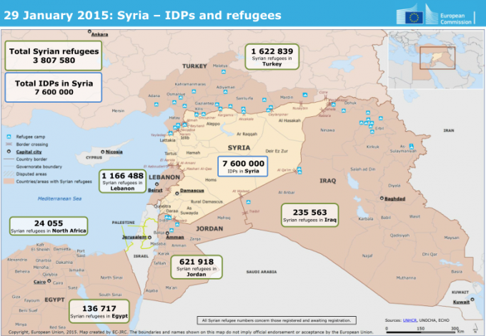
Syria regional refugees now total about 4 million, IDPs 7-8 million

Slide 20
In Iraq, problem is internal displacement

Slide 21
US policy options
Continue current CT war, efforts on foreign fighters and finance
Retrain ISF, support National Guard in Iraq
Start military rollback: is Mosul real, or a feint?
Train a new Syrian opposition force: in progress for up to 5000, insufficient to turn the tide
Unify and support existing Syrian opposition: not visible
“Safe area” along the Turkish border protected by no-bombardment zone, or in south
Boots? Loafers?

Slide 22
Question marks in Syria
Cooperation with Iran?
Russian-backed intra-Syrian dialogue: road to nowhere?
Other intra-Syrian efforts: Cairo? Paris?
UN freeze proposal: itself frozen
Governance once ISIS is rolled back
Syria reconstruction: Day After, Syria Transition Roadmap, UN ECSWA

Slide 23
The Levant will never be the same
Sectarian and ethnic divisions accentuated
Minorities obliterated
Partition? Independent Kurdistan? Sunni regions in Iraq? Alawite enclave in Syria?
Safe haven for international terrorists? Khorasan group
Iran wins with Assad, loses big with partition
Russia still has its chips on Assad but loses big if he falls
Turkey, Lebanon, Jordan at risk

Slide 24
Extras

Slide 25
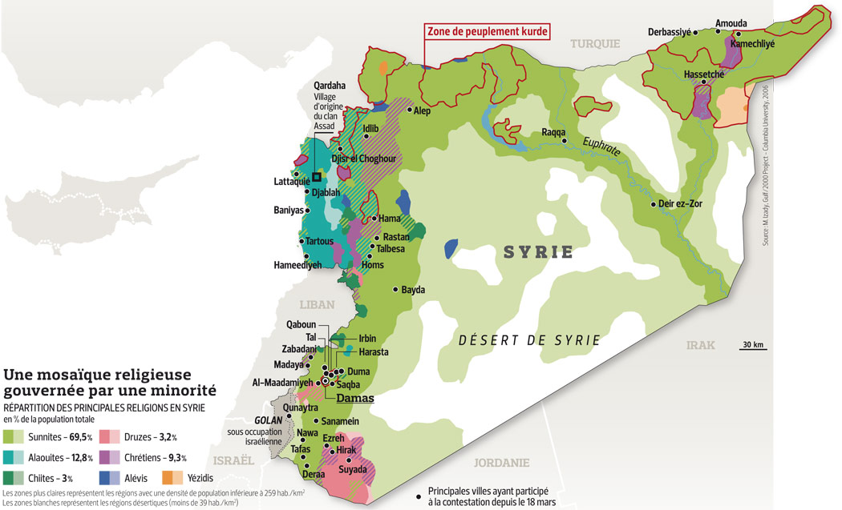
A very mixed population…

Slide 26
…but an Alawite dominated government
Alawite heartland is in the west along the Mediterranean, where there was a state 1920-36, under French mandate
Even there they are majority only in the countryside, not in cities, another large group is now in Damascus
Total is about 11/12% of Syria’s 23 million
Heterodox sect, generally regarded as Shia (Alawi=followers of Ali, cousin and son-in-law of The Prophet)
But the regime maintained good relations with Sunni merchants and tried to reduce distinctions with Sunni Islam
Ideology is tolerant, multiethnic, nondemocratic, single-party state
Power concentrated in Damascus and a very small number of family members

Slide 27
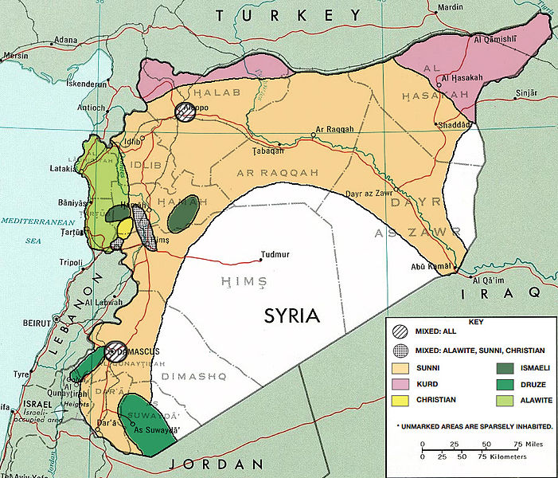
Pre-war ethnic/sectarian map

Slide 28
Sunni sea, minority islands
Sunni majority in most areas, even Latakia
Minorities concentrated in specific areas
Druze in Suweida and SW of Damascus
Kurds in north in three different areas
Christians and Ismailis in Hama governorate
Major cities (Aleppo, Damascus, Homs, Hama) mixed

Slide 29
A short history of Iraq
Post WWI British mandate after Ottoman collapse
Sunni monarchy established by plebiscite 1921
Independence 1932, Kurdish and Shia revolts
Coups 1936-41
Retaken and occupied by the Brits
Founding member of the UN in 1945
Qasim coup 1958, assassinated by Ba’ath 1963
Ba’ath displaced quickly, returns to power 1968

Slide 30
A short history continued
Saddam Hussein takes power 1979
Iran-Iraq war 1980-88
Iraq invades Kuwait 1990
US-led coalition liberates Kuwait in “Desert Storm” 1991
US-led invasion and occupation of Iraq 2003/4
Sunni/Shia virtual civil war 2006
“Surge” 2006/8
US withdrawal end 2011

Slide 31
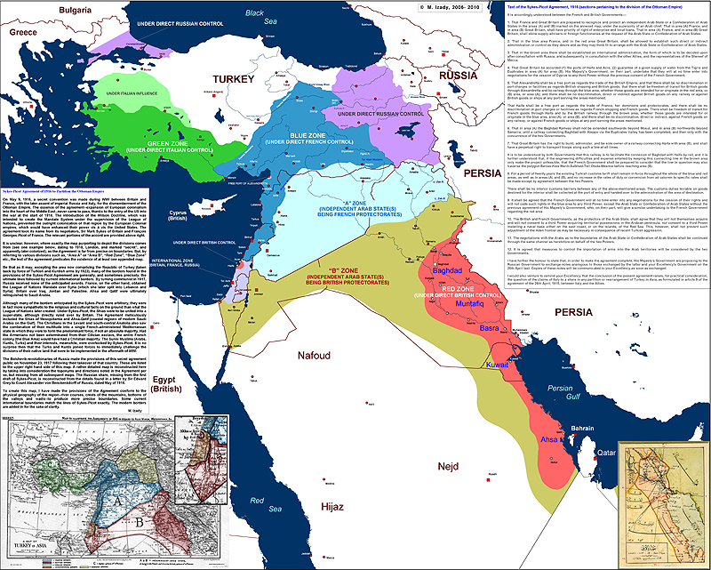
Sykes Picot

