Slide 1
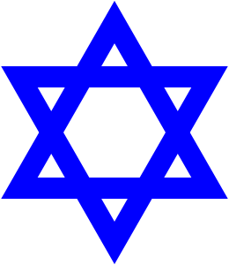
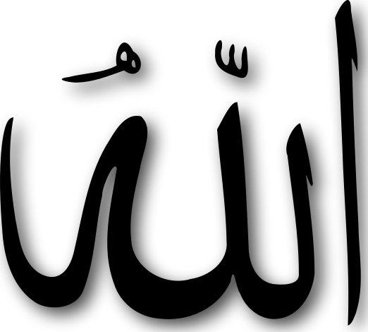
What Has God Got To Do With It?
The Role of Religion in the Arab-Israeli Conflict
Daniel Serwer
daniel@serwer.org
www.peacefare.net

Slide 2
The basics
The Torah—the five books of Moses—are fundamental for Jews: God tells Abraham to leave his home in Ur to go to the land of Canaan, which he promises to the descendants of Abraham, starting with his son Isaac and grandson Jacob, later named Israel.
The Quran is fundamental for Muslims: Ibrahim there is also a key patriarch told to leave Ur to build the Ka’bah in Mecca with his son Ishmael.
Both traditions agree that Abraham/Ibrahim is the originator of monotheism, but they trace their own origins to two different sons.

Slide 3
Jews and the land (Haaretz)
Jews have long regarded the land of Israel as their ancestral home, one to which some seek to return.
The return to Canaan after exile in Egypt is the central narrative of the Torah, one for which there is virtually no archeological evidence but lots of belief that it really occurred.
The Jews were chased from the Holy Land in 587 B.C. by the Babylonian King Nebuchadnezzar.
And again in 70 A.D. by the Roman Emperor Titus.

Slide 4
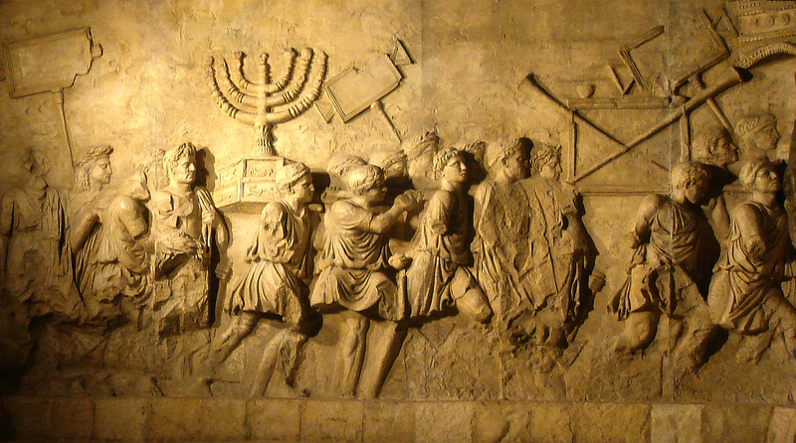
Here are the Romans looting the candelabra from the second Temple (Arch of Titus, Rome):

Slide 5
In Islam, Jerusalem is 3rd, but still important
Mecca, where Mohammed was born, and Medina, where he established his rule, come before Jerusalem as holy sites.
But according to the Quran, Mohammed on his Night Journey is transported to “the farthest mosque” (al Aqsa) on his steed Buraq and ascends from there to heaven.
Al Aqsa mosque and the Dome of the Rock were built on the Haram al Sharif (the Noble Sanctuary), known to Jews as the Temple Mount.

Slide 6
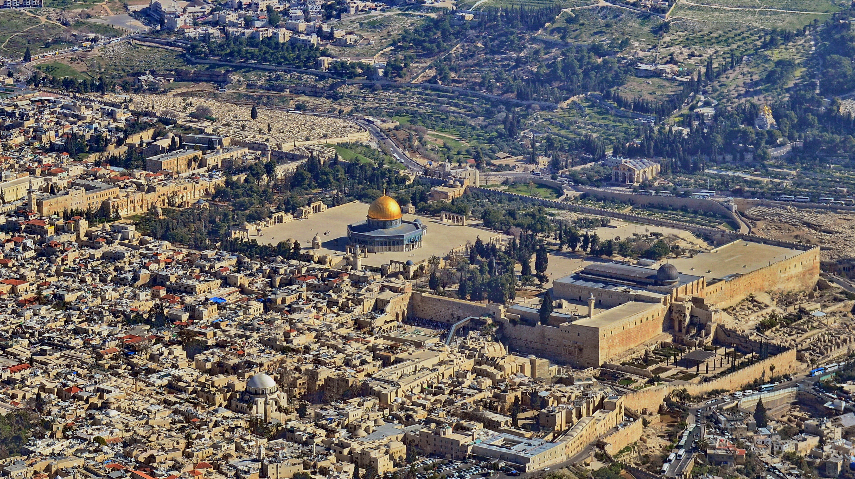
The Haram al Sharif/Temple Mount

Slide 7
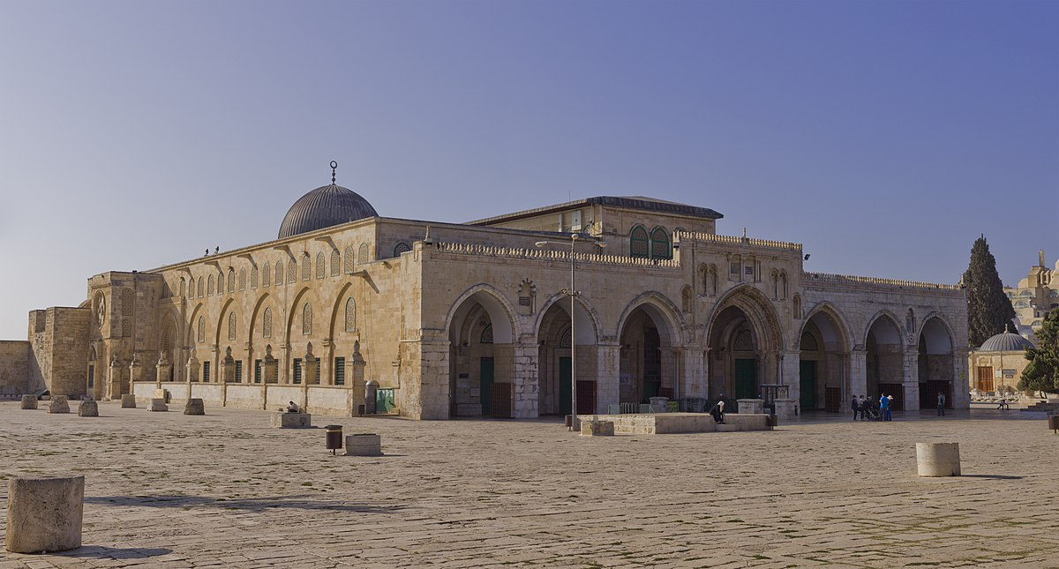
Al Aqsa (the Farthest Mosque): 705, but rebuilt several times since due to earthquakes

Slide 8
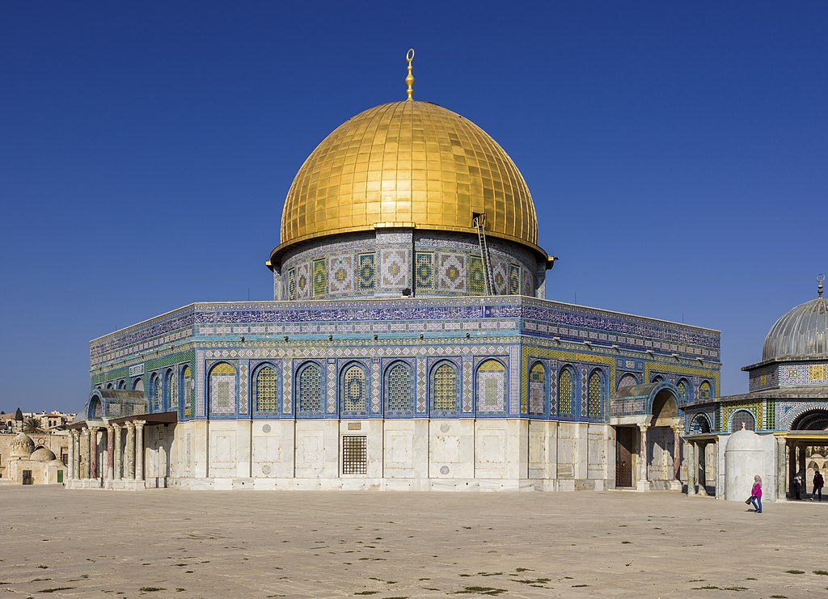
Here is the Dome of the Rock: first completed 691, but in its current form since the 12th century (the gold-plated roof is 20th century):

Slide 9
So what is the rock?
Muslims and Jews both believe it is Mount Moriah, where God called on Ibrahim/Abraham to sacrifice his son and then relented.
Jews believe the sacrifice was to be of Isaac, his younger son by Sarah, Muslims believe it was Ishmael, his elder son by Hagar.
For Jews, the Temple Mount is sacred not only because it includes Mount Moriah but it is also where the First and Second Temples stood.
Both were destroyed on Tisha B’av, (the ninth of Av) which is also the date of other Jewish disasters.

Slide 10
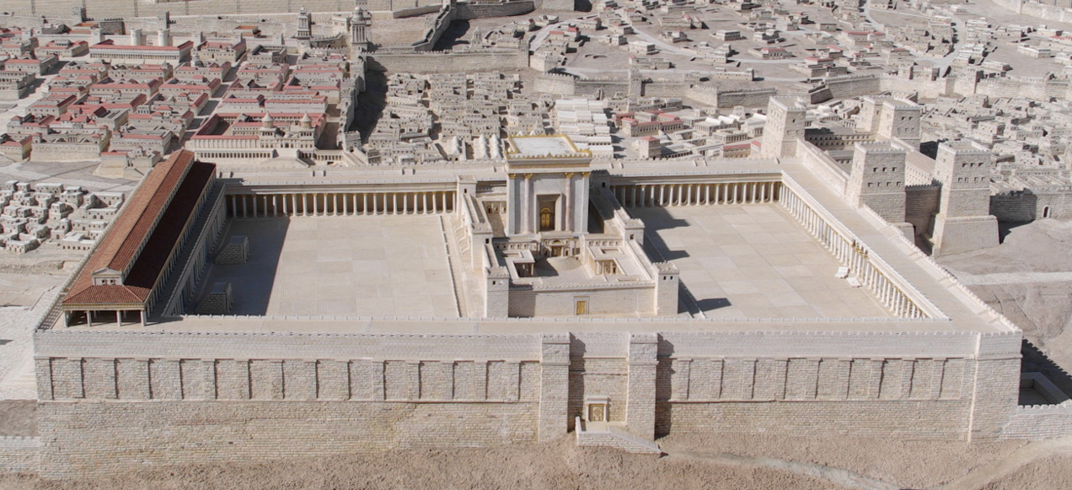
Here is what some think the 2nd Temple looked like:

Slide 11
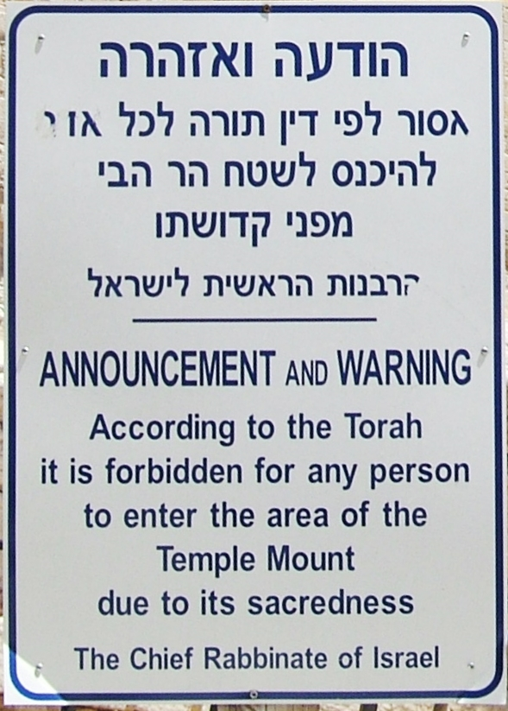
Muslims pray on the Haram al Sharif every day, but Jews (and other non-Muslims) are traditionally not allowed to pray on the Temple Mount:

Slide 12
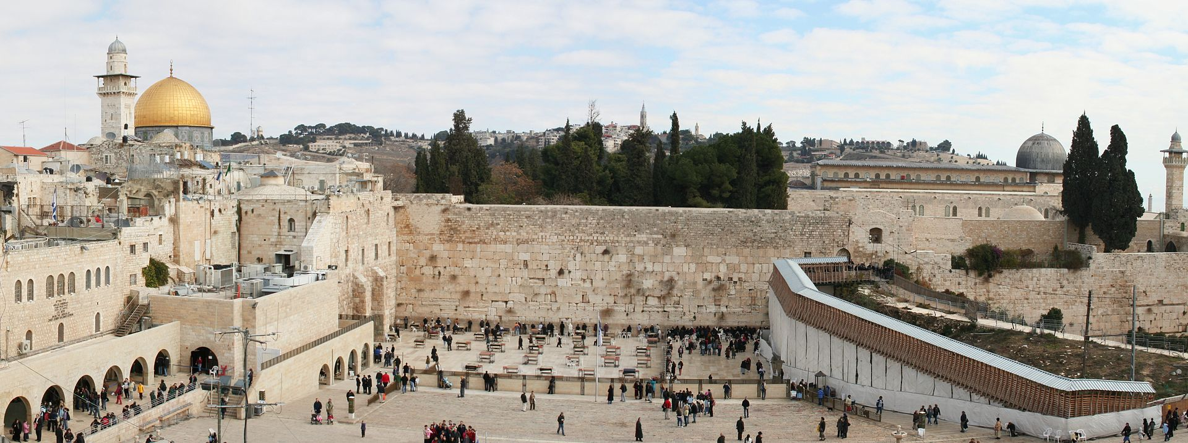
Instead Jews pray at the “wailing,” Western wall, a retaining wall of the 2nd Temple

Slide 13
What does history tell us?
What we’ve got here are two religious traditions telling not so different stories about approximately the same place.
But the early history is more one of tolerance than conflict.
Muslims first conquered Jerusalem in 637, taking it from the Byzantine Christians after a siege.
The Muslims, unlike the Christians, allowed Jews to live and worship in the city. That’s the good news.
Muslims, Jews, and Christians have sometimes fought over Jerusalem and sometimes shared it without too much difficulty for more than a thousand years.
The bad news is that this long history has little to do with contemporary conflicts.

Slide 14
The real prelude to contemporary issues started in the 19th century
By 1850, Jerusalem’s population was 25,000! Today: 858k
Christians, Muslims, Armenians, and Jews lived near favorite shrines, mostly peacefully.
But by the late 19th century, nationalism had infected both Jews and Arabs: Herzl published Der Judenstaat in 1896, and Arabs were protesting Ottoman rule.
The British entered Jerusalem in 1917, and promised “a national home for the Jewish people” in Palestine, where they were about 10% of the population.
Arabs regard Balfour Declaration as inconsistent with promises made to them.
Modern conflict between Arabs and Jews, as well as between Arabs and British and Jews and British, dates from this colonial period.
This included anti-Jewish riots starting in the 1920s to protest growing immigration.

Slide 15
Sharpened hostilities
Jewish migration to Palestine increased dramatically in the 1930s as a result of conditions in Europe.
This led to the Arab revolt of 1936-39 and British limitations on Jewish immigration thereafter.
In World War II, the Mufti of Jerusalem was aligned with the Axis against the British while some Arabs and most of the Jews aligned with the Allies.
Post war, migration of Jews to Palestine continued despite British attempts to block it.
The General Assembly voted the partition of Palestine in 1947, to succeed the British colonial mandate:

Slide 16
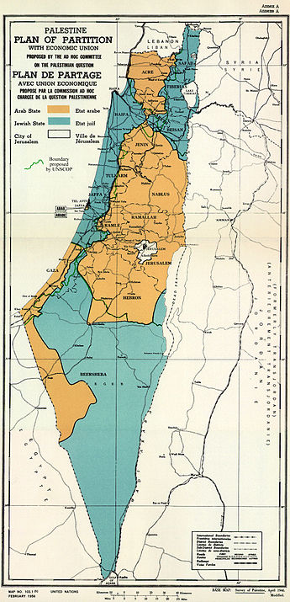
The partition plan

Slide 17
War ensues
Most Jews accepted the partition, though it is notable that Netanyahu’s father did not.
Most Arabs rejected it, and the Arab countries invaded.
Both Arabs and Jews at this point were predominantly secular.
Jewish Zionism was mostly Socialist.
Arab nationalism was mostly disassociated from Islam and Arab Palestinians were both Christian and Muslim.
The Jewish forces won the war, expanding significantly their borders:

Slide 18
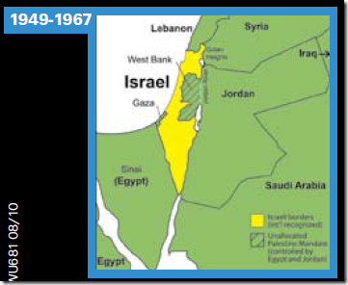
Israel’s changing borders

Slide 19
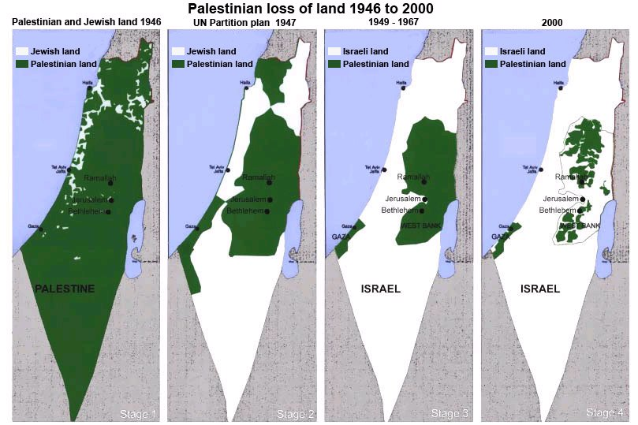
Or, in the Arab view:

Slide 20
Religion is not so important to this history
The 1956 Suez war was about Egypt closing the straits of Tiran and the Suez Canal.
The 1967 Six Day war launched by Israel was also in part about the straits of Tiran.
It resulted in the capture by Israel of Gaza, all of the Sinai Peninsula, all of Jerusalem, the West Bank, and the Golan Heights.
The 1973 Yom Kippur war, launched by the Arabs, came close to disaster for Israel, but in the end it lost nothing.
The 1982 Lebanon war, in which Israel invaded its northern neighbor to attack the PLO, was secular on both sides, though the Israelis allied themselves with Lebanon’s Maronite Christians.
None of these wars were conceived or justified in explicitly religious terms by either side.

Slide 21
Nor was it so important in the Oslo period
The Oslo process in the 1990s between Israel and the PLO was likewise mainly secular in character.
The result was limited self-government by the Palestinians in both Gaza and parts of the West Bank, intended as a 5-year temporary arrangement.
The Oslo process also led after 2000 to explicit acknowledgement of a two-state solution as the goal.
Israel was to continue to be a homeland for the Jewish people, albeit with a large and growing Muslim minority. Palestine was avowedly a secular state, but one with important Muslim and Christian roots, even if the Christian population was declining.
The main source of religious friction in the Oslo process was, and still is, our favorite subject: Jerusalem, though there have also been frictions over the Cave of the Patriarchs in Hebron and Joseph’s Tomb in Nablus.

Slide 22
Things are changing
Israel’s Jews, once predominantly secular and Socialist, are becoming more religious, due largely to demography but also to the rise of Messianic fervor after the 1967 war.
Israel’s fragmented politics provides openings to religious political parties, whose support was needed by the right to gain majorities in the Knesset.
The Palestinian population has become more Muslim (Christians <1%) and more Islamist due to the failures of Arab nationalism in the region.
The 1979 Iranian revolution saw the creation of an explicitly Muslim, albeit Shiite, theocracy.
A Sunni Islamist group, Hamas, gained traction among Palestinians, while a Shiite Islamist group gained traction in Lebanon, both supported by Iran.

Slide 23
So today the situation looks different
Jews, frightened by the terrorism of the second Intifada (2000-5) and Iran’s rise, are insisting that the Palestinians not only recognize Israel as a state, which the PLO already did, but also recognize it explicitly as Jewish.
Muslims have spawned more radical Islamist groups, including not only Hamas and Hizbollah but also Al Qaeda and the Islamic State.
All these groups refuse to accept the existence of Israel, never mind its Jewish character.
They explicitly aim to destroy it and re-occupy Jerusalem in the name of Islam.
While Islam is not generally anti-Jewish, these extremist groups are.

Slide 24
Religious pressures are rising
Leaving aside the extremists, Jerusalem is the nub of religious contestation in the Jewish/Arab conflict.
While Yasser Arafat drew on Islamist rhetoric, the Palestinian Authority remains secular, even if Israel’s government is increasingly Jewish nationalist.
Both Israeli and Palestinian leaderships however feel pressure from religion.
Can they come to an agreement?

Slide 25
Focus on Jerusalem, with a tip of my hat to Israeli scholar Lior Lehrs:
The city has been entirely under Israeli jurisdiction since 1967, when Israel captured East Jerusalem from Jordan.
There are several issues in Jerusalem, not only one.
First is the question of who will have sovereignty over different neighborhoods. That strikes me as essentially a non-religious issue, though devout Muslims and Jews do occupy some of those neighborhoods.
The second is the border regime and cooperation between two city administrations, which is clearly a non-religious issue.
The third is the question of the Temple Mount/Haram al Sharif and other parts of the Old City and environs.
This is at least in part a religious issue, as it touches on both Jewish and Muslim beliefs and identity.

Slide 26
The Haram al Sharif (noble sanctuary)
Muslims pray there virtually every day.
Access is controlled by the Israeli authorities, but the site and the mosques are managed by a Waqf, or religious endowment.
The Grand Mufti of Jerusalem is in charge of religious activities on the site.
This status quo is only occasionally problematic, as in September 2000 when Ariel Sharon visited (triggering the 2nd Intifada) and last July when Israel installed metal detectors at the access points in response to a terrorist attack mounted from the Haram al Sharif.

Slide 27
Jordan’s role
The Jerusalem Waqf is funded and controlled by Jordan, which has been promised a role in any future arrangements, in its 1994 peace treaty with Israel:
Article 9: “Israel respects the present special role of the Hashemite Kingdom of Jordan in Muslim Holy shrines in Jerusalem. When negotiations on the permanent status will take place, Israel will give high priority to the Jordanian historic role in these shrines.”

Slide 28
The Temple Mount
The Israeli government generally upholds the prohibition on Jewish worship on the Temple Mount, but secular Jews do visit there.
I went up in 1999, when there was a widespread expectation of peace. It seemed like half the Israeli army was there too, unarmed.
But that halcyon period is long gone.
Any hint of Israeli intention to change the status quo on the Temple Mount brings vigorous protest from Muslims.
Increasingly, religious Jews also visit the site. Some want to pray there, and a few would like to destroy the Dome of the Rock and rebuild a 3rd Temple.

Slide 29
The rest of the Old City and related areas
Two choices: divided sovereignty or a special international regime.
Israelis favor a special international regime, without dividing sovereignty.
Palestinians favor divided sovereignty, with the option thereafter of negotiating a special regime.
The Kotel, where Jews pray, would be under Israeli sovereignty, but the Palestinians have not conceded sovereignty over its entire length.
The Haram al Sharif would continue to be administered by the Muslim community, but the Israelis want it under their sovereignty.

Slide 30
Obstacles to agreement:
Public opinion over sacred sites is difficult to win: two-level game.
Lack of preparation for negotiation on an issue as sensitive as Jerusalem.
Postponement to the end-game reduces the possibility of tradeoffs.
Other stakeholders beyond Israel and Palestine: Muslim, Jewish, and Christian.
Differing interpretations of history and religion.

Slide 31
Politics, not policy, is the problem
Not inherently so bad: the policy differences have narrowed significantly since Oslo
But political conditions among Jews and Arabs have worsened
The Netanyahu government depends on uncompromising religious parties, a situation the prime minister prefers, weakened by corruption scandals
The Palestinians are split between the West Bank under Fatah control and Gaza under Hamas—reconciliation ongoing, but not complete, Mahmoud Abbas weakening
The Americans are ineffectual and unreliable: Trump decision precipitated a Knesset decision to require 2/3 majority to change the city boundaries
Priority has moved to ISIS , Al Qaeda, and Iran, with Sunni states aligning with Israel and less interested in the Palestinians

Slide 32
Bottom lines
This conflict is not about religion or even history.
It is about identity, formed on the basis of selective narratives.
A narrative that emphasizes tolerance and mutual respect is also possible: Ishmael and Isaac both attended Abraham’s funeral.
But it is also possible to view this as a struggle for control over territory between incompatible and mutually hostile communities.
There is a choice, one that results from the internal politics of each community and the influence the international community can wield.
What would you choose?

Slide 33
What Has God Got To Do With It?
The Role of Religion in the Arab-Israeli Conflict
Daniel Serwer
daniel@serwer.org
www.peacefare.net

Slide 34
Fast forward: tolerance and intolerance
Christians retook Jerusalem 1099, expelled the Jews and Christianized the mosques, and keep it until 1187.
Then Saladin gained it by negotiation, de-Christianized it, but allowed the Jews to re-enter.
It was destroyed by one of his successors in 1219 and 1220, to prevent it falling into Christian hands.
The city was retaken by the Holy Roman Empire in 1229 until 1244, when it was again sacked by Muslims.
The Mamluks were in control of the city by 1250 and welcomed the Jews back, once again.
The Ottomans took over Jerusalem in 1517 and welcomed Muslims, Christians and Jews under Suleiman the Magnificent

