Slide 1
“Pathways for Peace”:
Key Substantive Findings and Future Research
Charles T. Call
Senior External Advisor for the Report
Associate Professor of International Peace and Conflict Resolution
School of International Service
American University

Slide 2
Key Substantive Findings
1) The trends of violent conflict have worsened since 2010.

Slide 3
Key Substantive Findings
2) Income inequality (vertical) as a causal factor for violent conflict has inconclusive empirical support. Instead horizontal inequalities have strong support.

Slide 4
Key Substantive Findings
3) Actors and their agency and narratives are key -- it isn’t just about institutions.

Slide 5
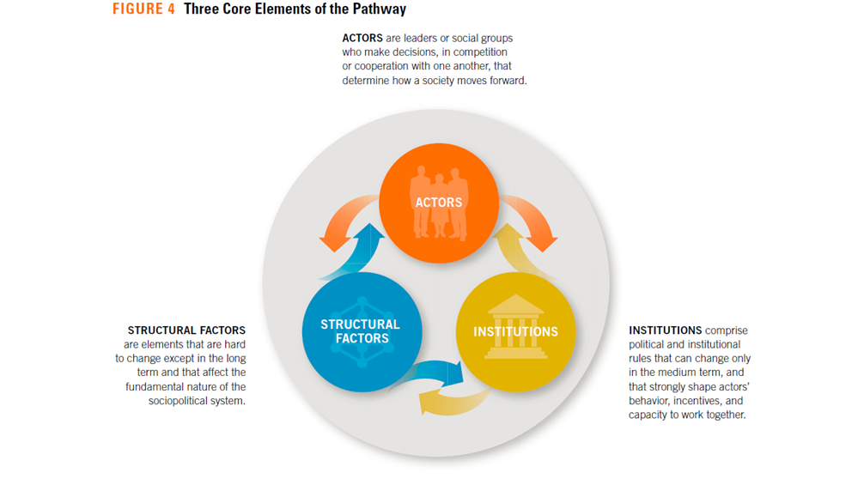

Slide 6
Key Substantive Findings
4) States are the key actors in violence prevention, but need approaches above and below the state.

Slide 7
Key Substantive Findings
5) Conflict forms of exclusion cluster around key arenas – land, political power, justice, security, access to services.

Slide 8
Exclusion
Security
Land
Political
Services

Slide 9
Key Substantive Findings
6) The costs of conflict response are prohibitive, and prevention is a sensible investment.

Slide 10
Pathways for Peace:
Inclusive Approaches to
Preventing Violent Conflict
Elements of a
Research Agenda

Slide 11
Some Research Questions
What are the specific dynamics of exclusion? How do diverse forms of exclusion intersect in affecting violence?
What are the various impacts of MDBs and development agencies in Middle-Income Countries?
We need more qualitative research on political settlements/social contract and economic policies and distribution.
And we need more qualitative research on national-international interaction in cases of prevention.

Slide 12
Some Research Questions (continued)
5) We lack sound evaluations of diplomatic and development interventions, how they interact, and how much impact they have.
6) How and when are grievances mobilized into violence (triggers)?
7) How can knowledge about preventing municipal/urban violence be drawn upon more effectively to prevent mass political violence?

