Slide 1
From War to Peace in the Balkans, Middle East, and Ukraine
https://link.springer.com/content/pdf/10.1007/978-3-030-02173-3.pdf
www.peacefare.net
daniel@serwer.org

Slide 2
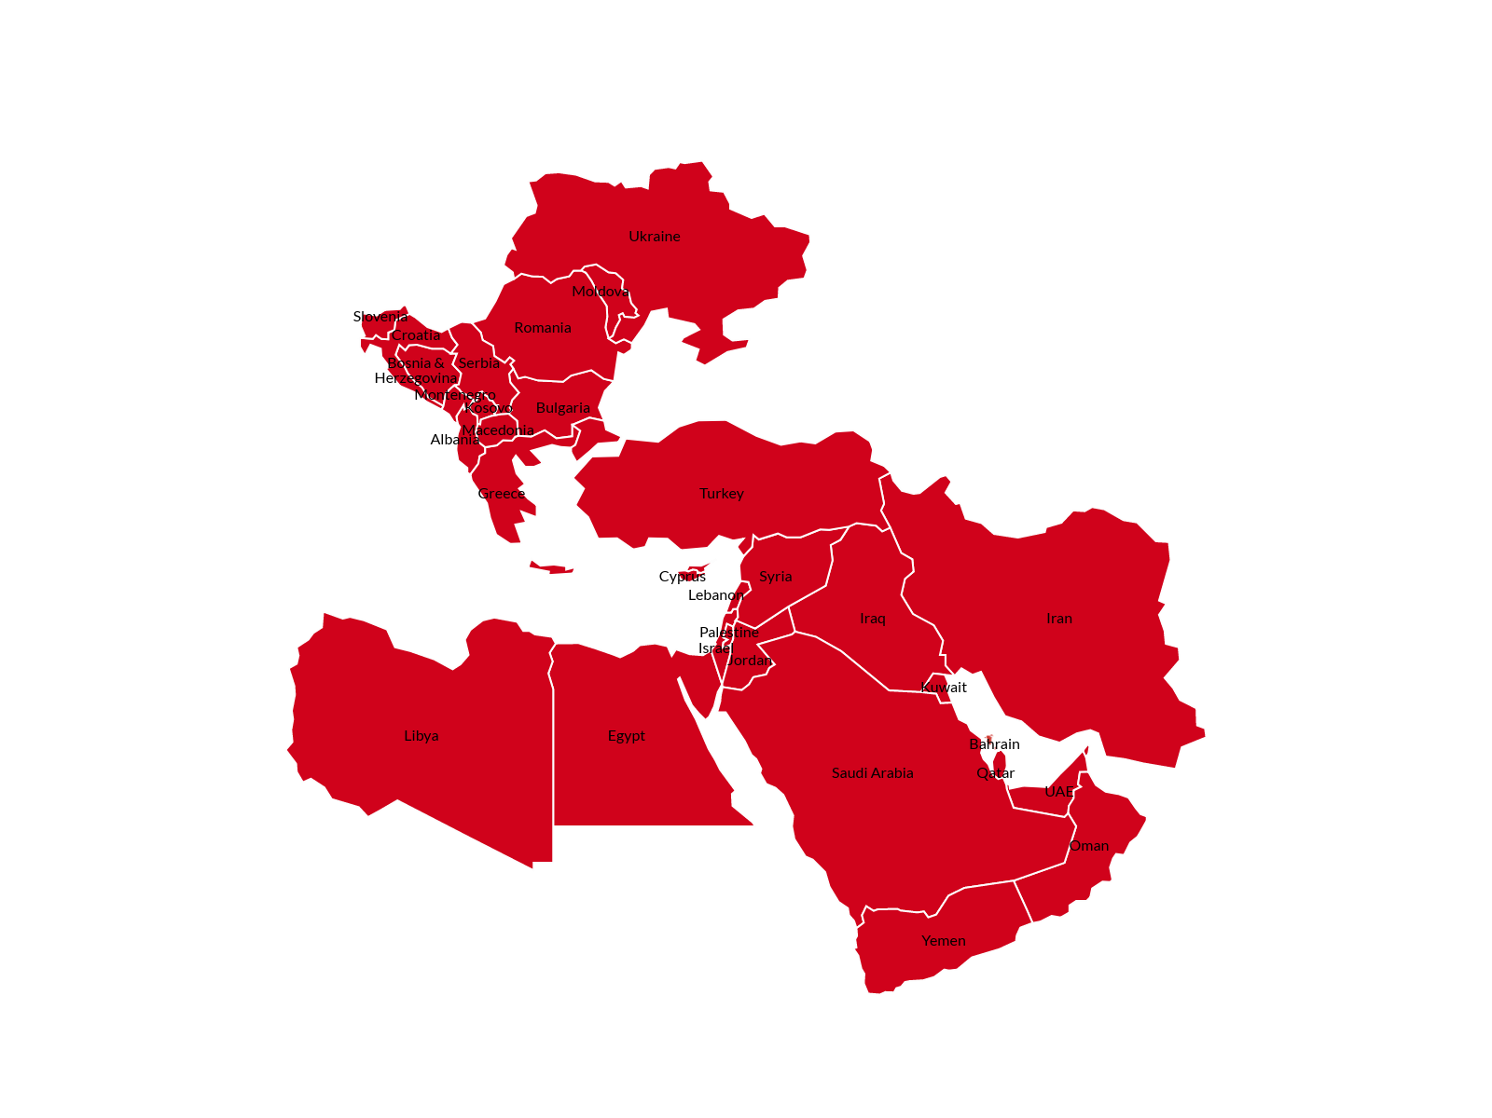
This trio isn’t far fetched:

Slide 3
The relationship is not just geographical
The Middle East and Balkans share a history in the Ottoman Empire, which was patriarchal and exploitative but did not make the efforts Western Europe indulged in to homogenize populations.
The result is a similar hodge-podge of non nation-states:
In the Balkans, Muslims, Serbs, Croats, and Albanians, not to mention Macedonians, Vlachs, Turks, Ashkalli, Jews and others.
In the Middle East, Sunni, Shia, Kurds, and Christians of many denominations, not to mention Jews, Mandaeans, Yezidis, Shabak, and others.
The Russians and Soviets failed to extirpate Ukrainian identity, which coexists and competes with Russian ethnic identity, especially in Crimea.

Slide 4
This history has political implications
The concept of group rights, which exists in both the Balkans and the Middle East, is in part an Ottoman legacy.
This assigns to some sectarian or ethnic groups veto power over key issues and some measure of self-governance.
The most important group right is the right to form the state and to claim privileges in it that others do not share.
We see that claim asserted by Jews in Israel, Turks in Turkey, Arabs in Syria, and Kurds in Kurdistan.
The problem of course is that the borders of states do not correspond to the distribution of populations.

Slide 5
Who is included?
Where rights are not attached to the group but to individuals, there are fewer problems, provided minorities receive equal protection.
But that proviso is hard to fulfill in the Balkans and the Middle East, where autocratic claims to do so are rarely fulfilled, liberal democracies and independent judiciaries are nonexistent.
Shia in Iraq did not believe Saddam Hussein’s promises of equal treatment any more than Sunnis in Syria believe Assad’s or Arabs believe the analogous promises in Israel or Iran.
Even in relatively tolerant Iraqi and Syrian Kurdistan, not all minorities are convinced of equal treatment.

Slide 6
The consequences of exclusion
Exclusion in weak states can result rebellion or challenges to borders, or both: that’s what we saw with the insurgency of the Islamic State, which sought to erase the border between Iraq and Syria.
States that exclude part of their population from political power, economic benefits, or social privilege tend to fail, as Acemoglu and Robinson have shown.
A good deal of what we’ve seen in the Middle East in recent years fits this pattern: certainly Assad’s Syria, Saddam’s and Maliki’s Iraq, Saleh and Hadi’s Yemen, Qaddafi’s Libya.

Slide 7
Teleology matters
You need to know where you are going in order to get there.
The Balkans region has a preferred direction—Europe and NATO—and some examples to follow: Slovenia, Croatia, Bulgaria, Romania.
The Middle East has only the Tunisian example, which is too fragile and far from the center of gravity and too small to drag anyone else in its wake.
The GCC crisis complicates conflicts throughout the Middle East, because Qataris, Saudis and Emiratis prefer war on someone else’s territory.

Slide 8
Other lessons learned
• Inclusive leadership is key to starting, preventing, and ending wars: Milosevic and Tudjman in the Balkans set a pattern also seen in Syria, Yemen, Libya
• Early prevention can work, with adequate resources: UN and GCC in Yemen, UN and Arab League in Syria but resources inadequate
• Ethnic partition will not: Iraqi Kurdistan: no agreement on border
• International contributions can be vital: US never cared about Syria, but Russia, Turkey, and Iran did; nor Libya, but UAE did
• Neighborhood counts: Syria/Iraq/Iran, Yemen/KSA, Libya/Egypt
• Power sharing and decentralization can help: Libya, Iraq

Slide 9
Prospects are not good
Peace agreements in the Balkans were all between two sides: Bosnian Federation, Dayton, Ahtisaari, Ohrid, Prespa.
Where they were not, as in Bosnia, we reduced them to bipolarity.
Ukraine is bipolar: only political will blocks the Minsk 2 agreement.
Middle Eastern conflicts are often multi-polar.
In Syria, it is hard to even count the “sides”: Assad, supported by Russia and Iran, Islamic State, HTS/AlQaeda, Arab insurgents supported by Turkey, Kurds supported by the US.
The GCC split has heightened proxy conflicts in Libya and Yemen.

Slide 10
It’s the region, like it or not
While often discounted, it is hard to picture restoration of stability in the Middle East without some sort of regional compact.
America’s current effort to polarize the region between Arabs and Iran is not in my view in the interests of either.
MEI’s Middle East Dialogue has enunciated principles that might serve as a foundation, the first of which is respect for territorial integrity.
Others suggest respect for individual rights, inclusion, and diversity.
I might have liked this “Baghdad Declaration” to refer also to decentralization, which has proven vital to Balkan peace agreements.
The Middle East is the only major region of the world with no over-arching security structure. It needs one.

Slide 11
Where to start?
Colleagues in the Middle East Dialogue have suggested the place to start is with threat perceptions.
They differ: Iran views its presence in Lebanon and Syria as countering threats, but Arab Sunni states see it as a threat to them.
Another place to start is where interests overlap: Saudi Arabia and Iran both seem to be concluding that Iraq’s stability serves their interests.
A third place to start is where common interests are obvious, as with global warming, the youth bulge, and water shortages.
A fourth place to start is with indigenous conflict management mechanisms, including both tribal practices common throughout the Middle East and the practices surrounding religious pilgrimages.

Slide 12
Despair is not a policy
The US has been trying to reduce its presence in the Middle East for at least a decade.
It has failed, because doing so leaves vacuums that have been filled by malevolent forces.
What it will take to withdraw is better diplomacy, not more drones or cruise missiles.
We need to refocus on regional stability, which requires better leadership, more attention to conflict prevention, neighborhood engagement, and decentralization.
It does not require redrawing borders to accommodate ethnic differences.
Those are primary lessons from the Balkans that should be applied in the Middle east.

Slide 13
From War to Peace in the Balkans, Middle East, and Ukraine
https://link.springer.com/content/pdf/10.1007/978-3-030-02173-3.pdf
www.peacefare.net
daniel@serwer.org

